Slide 1
Shiny App::Oil and Gas Production in Texas
Shuai He, nYC Data Science online Bootcamp
Dept. of Chemical & biomolecular Engineering, University of Houston

Slide 2
Outline
Introduction
Data manipulation
App design
Potential improvements

Slide 3
Introduction
Texas:
Long oil & gas production history (originated from 1900s);
State-wide, high production rate;
Conventional source -> unconventional source
Objective:
Collect available data and visualize the data

Slide 4
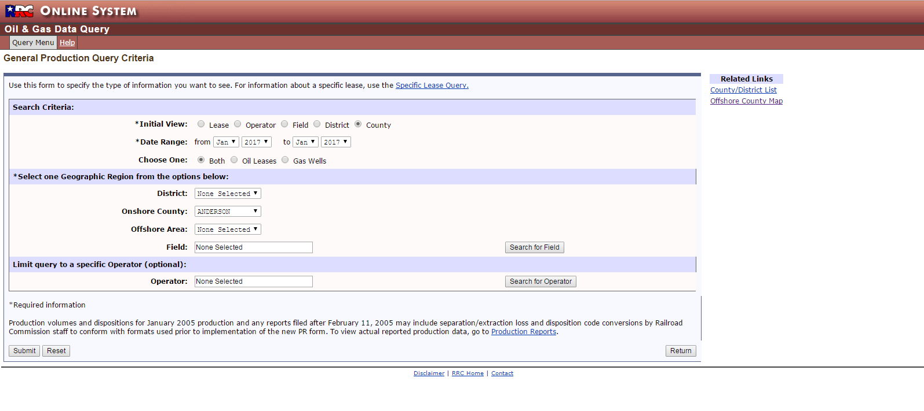
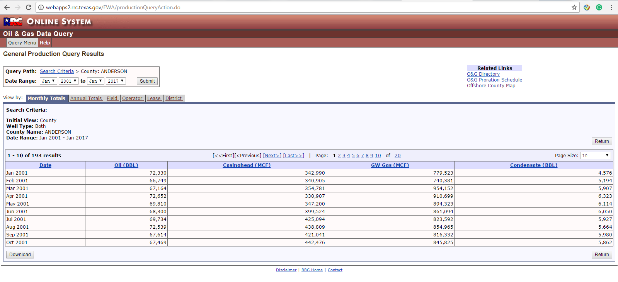
Dataset
Taxes railroad commission offers monthly production data
http://www.rrc.state.tx.us/oil-gas/research-and-statistics/production-data/
View by county
Date range
Choose county
owop
owgp
gwgp
gwop
Download the csv file

Slide 5
Data type
Oil and gas production
owop (BBL): oil production from oil wells
owgp (MCF): gas production from oil wells
gwop (BBL): oil production from gas wells
gwgp (MCF): gas production from gas wells
Oil wells
Gas wells
Oil
Gas

Slide 6
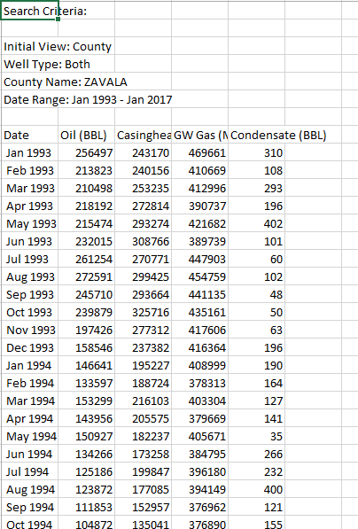
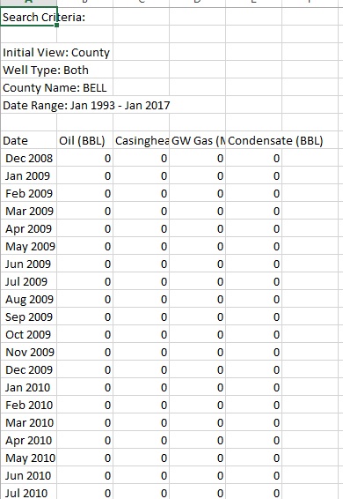
Data limitation
NA counties (239/254)
Separated files and missing data;
Production == 0 (cannot plot in log-scale);
Factor(s): county and date

Slide 7
Data manipulation
Overview:
Merge all csv files into one
Fill missingness/zero-value -> 1
Expand the date range to the full range
Approach:
Use pandas package in python

Slide 8
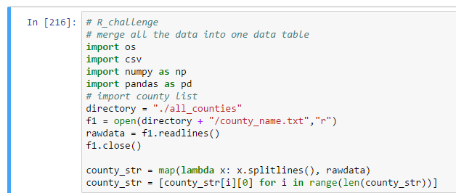
Data manipulation
Step 1: Collect the all county’s name, store in county_str, identify the NA county (s)

Slide 9
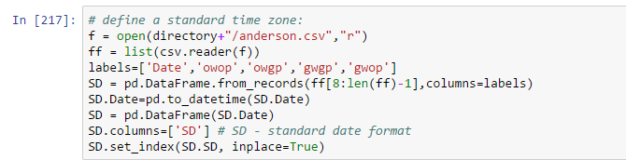
Data manipulation
Step 2: Define a full date range as a single column data frame

Slide 10
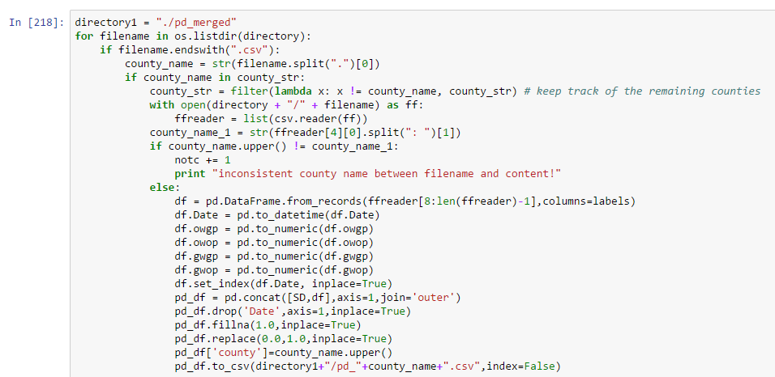
Data manipulation
Step 3: Concatenate with SD data frame and replace NaN/0 by 1.0

Slide 11
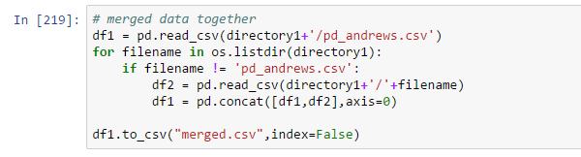

Data manipulation
Step 4: Merge data into one
Merged.csv
head(production_data)

Slide 12

App design
General features:
Select county(s) monthly production data
Visualize the location of corresponding county(s)
Select the date range
Log-scale plot
Select formation monthly production data
Formation: certain numbers of rock strata buried underground
Consists of multiple counties data
Visualize the location of the formation and corresponding counties
Data:
Merged.csv
Texas.csv

Slide 13
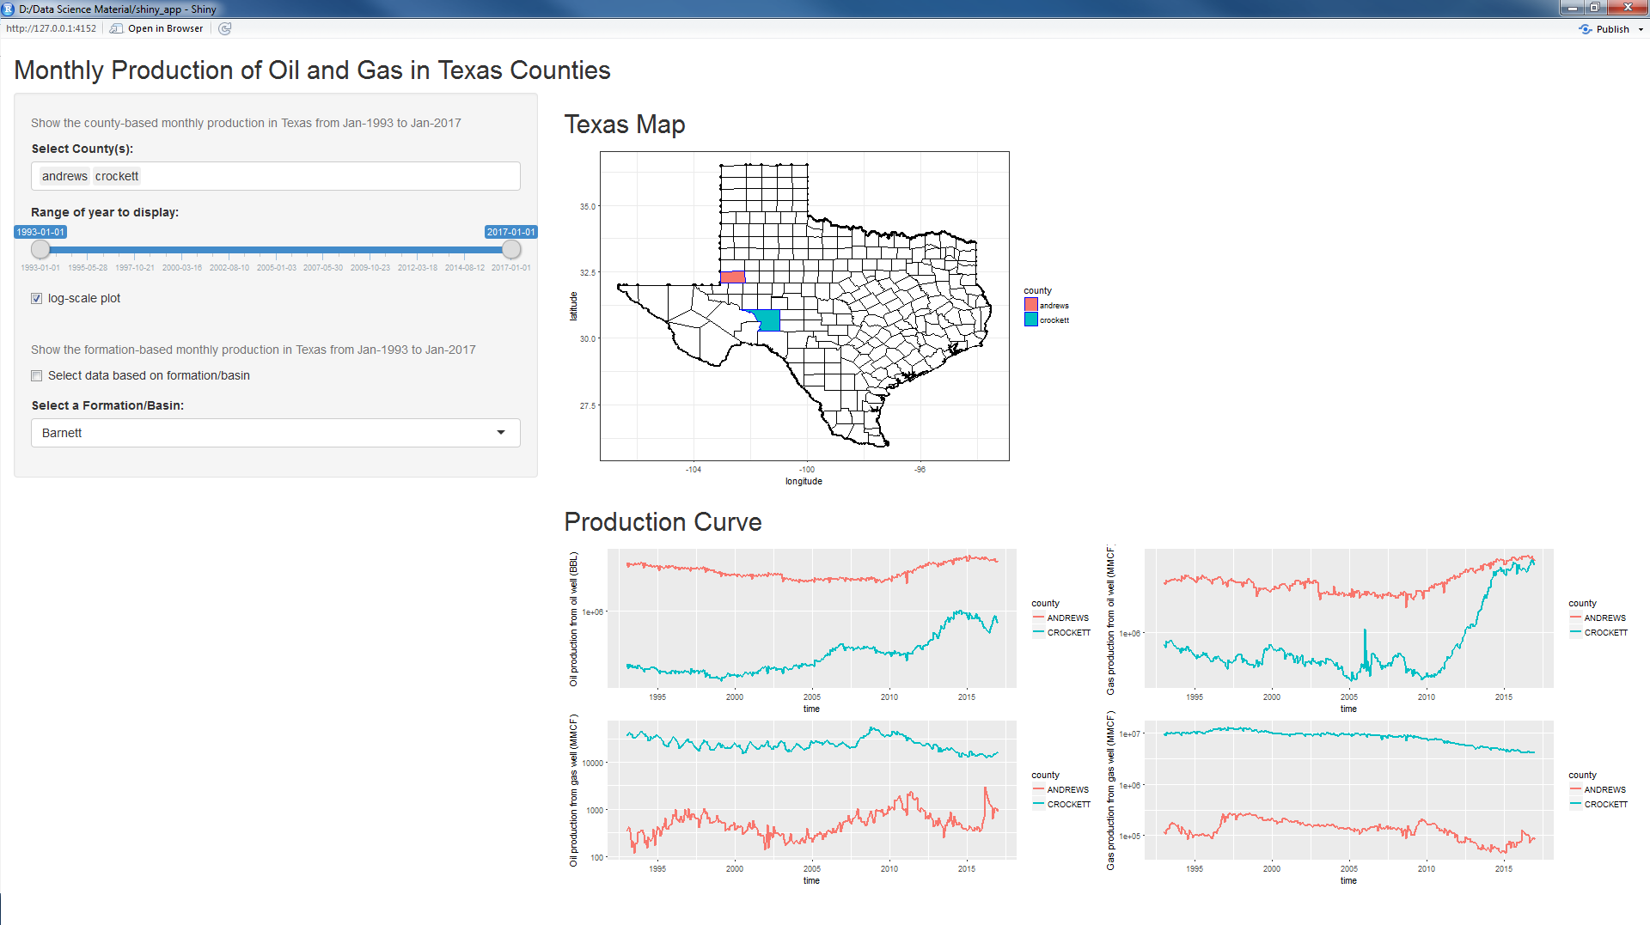
App design
Final product (select county(s)-based monthly production)

Slide 14
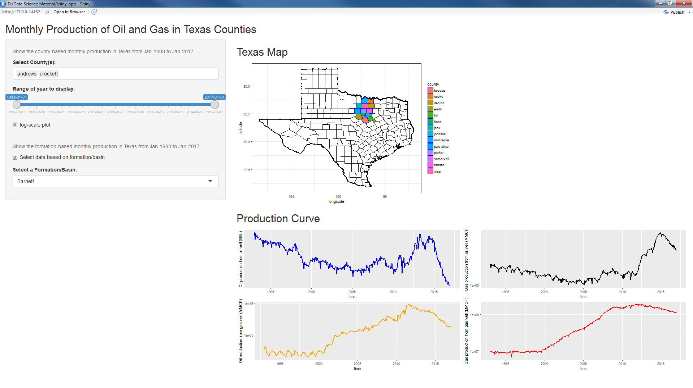
App design
Final product (select formation-based monthly production)

Slide 15
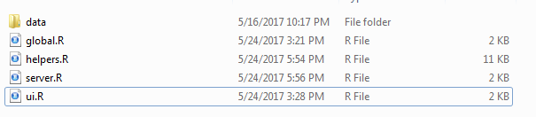
App design
Code structure
global.R
ui.R
server.R
helpers.R

Slide 16
global.R
library(shiny) library(dplyr) library(ggplot2) # Visualization of Texas Oil & Gas Production in Shiny # date manipulation texas = read.csv("./data/texas.csv", stringsAsFactors = FALSE) production_data = read.csv("./data/merged.csv", stringsAsFactors = FALSE) production_data$SD = as.Date(production_data$SD) names(production_data)[1] <- c('time') county_list = texas %>% distinct(county) county_list = rbind(county_list, c('ALL')) county_list = county_list %>% arrange(county) date1 = as.Date('01/01/1993', '%m/%d/%Y') date2 = as.Date('01/01/2017', '%m/%d/%Y') date_range = seq(date1, date2, by='month') Barnett = c('wise', 'denton', 'tarrant', 'johnson', 'jack', 'parker', 'palo pinto', 'erath','hood','bosque','hill','somervell','montague','cooke') Eagle_Ford = c('maverick', 'zavala', 'frio','atascosa', 'willson','live oak', 'mcmullen', 'karnes', 'de witt', 'gonzales', 'dimmit', 'la salle', 'webb','wilson') Cotton_Valley = c('anderson', 'bowie','camp', 'cass', 'cherokee', 'falls', 'franklin','freestone','gregg', 'harrison', 'henderson','houston','leon','limestone','marion','milam','morris', 'nacogdoches','navarro','panola','red river', 'roberson','rusk', 'sabine', 'shelby','smith','titus','upshur') Permian = c( "andrews","hockley","nolan","borden","howard","pecos","cochran", "irion","reagan","coke","jeff","davis","reeves","crane", "kent","scurry","crosby","kimble","sterling","dawson","lamb" , "terry","dickens","loving","tom green", "ector","lubbock","upton", "gaines","lynn","ward","garza","martin","winkler","glasscock", "midland","yoakum","hale","mitchell","crockett","terrell")

Slide 17
ui.R
library(shiny) # main UI shinyUI(fluidPage( titlePanel("Monthly Production of Oil and Gas in Texas Counties"), # main title sidebarLayout( sidebarPanel( helpText("Show the county-based monthly production in Texas from Jan-1993 to Jan-2017"), ## subtitle selectInput("county_var", # choose the residents label = "Select County(s):", choices = county_list, selected = NULL, multiple = TRUE), sliderInput("range", # choose the range label = "Range of year to display:", min = date1, max = date2, value = c(date1, date2) ), # monthly production #seq(date1, date2, by = 'month') checkboxInput("log", "log-scale plot", value = FALSE), br(), helpText("Show the formation-based monthly production in Texas from Jan-1993 to Jan-2017"), ## subtitle checkboxInput("check_formation","Select data based on formation/basin",value = FALSE), helpText("This function is under developement\n county list is not fully collected"), selectInput("formation_var", label = "Select a Formation/Basin:", choices = c("Barnett", "Eagle Ford", "Cotton Valley", "Permian"), selected = NULL) ), mainPanel(h2("Texas Map"), plotOutput("texas_county", width = 400, height = 400), h2("Production Curve"), plotOutput("pdcurve")) ) ))

Slide 18
server.R
if (input$check_formation) == TRUE
source('helpers.R') #pre-treatment shinyServer( function(input, output) { observeEvent(input$check_formation, { if (input$check_formation) { output$pdcurve <- renderPlot({ args <- switch(input$formation_var, "Barnett" = list(production_data, Barnett, input$range[1], input$range[2]), "Eagle Ford" = list(production_data, Eagle_Ford, input$range[1], input$range[2]), "Cotton Valley" = list(production_data, Cotton_Valley, input$range[1], input$range[2]), "Permian" = list(production_data, Permian, input$range[1], input$range[2])) do.call(formation_curve, args) }) output$texas_county <- renderPlot({ args1 <- switch(input$formation_var, "Barnett" = list(texas, Barnett), "Eagle Ford" = list(texas, Eagle_Ford), "Cotton Valley" = list(texas, Cotton_Valley), "Permian" = list(texas, Permian)) do.call(plot_county, args1) }) }

Slide 19
server.R
if (input$check_formation) == FALSE, then check if the user wants to visualize the data in log-scale
else { observeEvent(input$log, { if (input$log) { output$pdcurve <- renderPlot({ args <- list(production_data, input$county_var, input$range[1], input$range[2]) do.call(county_curve_log,args) }) output$texas_county <- renderPlot({ args <- list(texas, input$county_var) do.call(plot_county, args) }) } else { output$pdcurve <- renderPlot({ args <- list(production_data, input$county_var, input$range[1], input$range[2]) do.call(county_curve,args) }) output$texas_county <- renderPlot({ args <- list(texas, input$county_var) do.call(plot_county, args) }) } }) } }) } )

Slide 20
helpers.R
county_curve <- function(df, county_name, min_time, max_time) # county production data county_curve_log <- function(df, county_name, min_time, max_time) # county production data in log-scale formation_curve <- function(df, formation, min_time, max_time) # formation production data plot_county <- function(df, name) # color the corresponding counties in the map

Slide 21
helpers.R
county_curve <- function(df, county_name, min_time, max_time) { df_county = df %>% filter(county %in% toupper(county_name) & time >= min_time & time <= max_time) p1 <- ggplot(df_county, aes(x = time, y = owop)) + geom_line(aes(color = county), size = 1.0) + scale_y_continuous(limits = c(min(df_county$owop), max(df_county$owop))) + scale_x_date(limits = c(date1,date2))+ xlab("time") + ylab("Oil production from oil well (BBL)") p2 <- ggplot(df_county, aes(x = time, y = owgp)) + geom_line(aes(color = county), size = 1.0) + scale_y_continuous(limits = c(min(df_county$owgp), max(df_county$owgp))) + scale_x_date(limits = c(date1,date2))+ xlab("time") + ylab("Gas production from oil well (MMCF)") p3 <- ggplot(df_county, aes(x = time, y = gwop)) + geom_line(aes(color = county), size = 1.0) + scale_y_continuous(limits = c(min(df_county$gwop), max(df_county$gwop))) + scale_x_date(limits = c(date1,date2))+ xlab("time") + ylab("Oil production from gas well (MMCF)") p4 <- ggplot(df_county, aes(x = time, y = gwgp)) + geom_line(aes(color = county), size = 1.0) + scale_y_continuous(limits = c(min(df_county$gwgp), max(df_county$gwgp))) + scale_x_date(limits = c(date1,date2))+ xlab("time") + ylab("Gas production from gas well (MMCF)") grid.newpage() pushViewport(viewport(layout = grid.layout(nrow = 2, ncol = 2))) print (p1, vp = viewport(layout.pos.row = 1, layout.pos.col = 1)) print (p2, vp = viewport(layout.pos.row = 1, layout.pos.col = 2)) print (p3, vp = viewport(layout.pos.row = 2, layout.pos.col = 1)) print (p4, vp = viewport(layout.pos.row = 2, layout.pos.col = 2)) }
county_curve

Slide 22
helpers.R
formation_curve <- function(df, formation, min_time, max_time) formation_name = unlist(lapply(formation, toupper)) df_formation = df %>% filter(county %in% formation_name & time >= min_time & time <= max_time) %>% group_by(time) %>% summarise(sum_owop = sum(owop), sum_owgp = sum(owgp), sum_gwgp = sum(gwgp), sum_gwop = sum(gwop)) p1 <- ggplot(df_formation, aes(x = time, y = sum_owop)) + geom_line(color = 'blue', size = 1.0) + scale_y_continuous(trans = 'log10', limits = c(min(df_formation$sum_owop), max(df_formation$sum_owop))) + scale_x_date(limits = c(date1,date2))+xlab("time") + ylab("Oil production from oil well (BBL)") p2 <- ggplot(df_formation, aes(x = time, y = sum_owgp)) + geom_line(color = 'black', size = 1.0) + scale_y_continuous(trans = 'log10',limits = c(min(df_formation$sum_owgp), max(df_formation$sum_owgp))) + scale_x_date(limits = c(date1,date2))+xlab("time") + ylab("Gas production from oil well (MMCF)") p3 <- ggplot(df_formation, aes(x = time, y = sum_gwop)) + geom_line(color = 'orange', size = 1.0) + scale_y_continuous(trans = 'log10',limits = c(min(df_formation$sum_gwop), max(df_formation$sum_gwop))) + scale_x_date(limits = c(date1,date2))+xlab("time") + ylab("Oil production from gas well (MMCF)") p4 <- ggplot(df_formation, aes(x = time, y = sum_gwgp)) + geom_line(color = 'red', size = 1.0) + scale_y_continuous(trans = 'log10',limits = c(min(df_formation$sum_gwgp), max(df_formation$sum_gwgp))) + scale_x_date(limits = c(date1,date2))+xlab("time") + ylab("Gas production from gas well (MMCF)") grid.newpage() pushViewport(viewport(layout = grid.layout(nrow = 2, ncol = 2))) print (p1, vp = viewport(layout.pos.row = 1, layout.pos.col = 1)) print (p2, vp = viewport(layout.pos.row = 1, layout.pos.col = 2)) print (p3, vp = viewport(layout.pos.row = 2, layout.pos.col = 1)) print (p4, vp = viewport(layout.pos.row = 2, layout.pos.col = 2)) }
formation_curve

Slide 23
helper.R
plot_county
plot_county <- function(df, name) { df_sub = df %>% filter(county %in% name) g <- ggplot(df, aes(x=long, y=lat)) g + geom_point() + geom_polygon(aes(group = county), color = 'black', fill = 'white') + geom_polygon(data = df_sub, aes(fill=county), color = 'blue') + theme_bw() + xlab("longitude") + ylab("latitude") } # color the corresponding counties in the map

Slide 24
Potential improvements
More factors can be added
Field(s), offshore
Bury depth
Well(s) data

Slide 25
Thanks!
https://github.com/heshuaidavid/shiny-app

